Slide 1



CSE440 PRESENTATION
AUTONOMOUS ROBOT FOR INDOOR NAVIGATION USING A* SEARCH
PRESENTED BY
GROUP 9
PRESENTED TO
HAFSA MAHBUB 2021164042
SARDER HADEEKA HEA 1831384642
JAHINA ZAIYAN ADIBA 1931569642
DR. MD SHIFAT-E-RABBI
[MSRb]

Slide 2


CONTENTS
1
Introduction
5
Demonstration
2
6
Future Work Plan
Methodology
3
7
Conclusion
Tools Used
4
8
References
Challenges

Slide 3
Introduction
The main goal is to simulate the behavior of an autonomous robot navigating through a 2D grid environment using the A* search algorithm. The robot must find the shortest path from a starting point to a goal while avoiding obstacles.
This simulation provides a controlled setting where concepts of pathfinding, navigation, and obstacle avoidance can be tested and demonstrated.
Back to Contents

Slide 4


Methodology
Back to Contents
Overview
The approach involves setting up a 2D grid where each cell represents either an obstacle, the robot’s starting position, the goal, or empty space. The A* search algorithm is then applied to calculate the optimal path by considering both the movement costs and heuristic costs for reaching the goal.
The grid is visualized using Pygame, which allows real-time feedback and interaction with the environment.

Slide 5
Methodology
Back to Contents
Workflow
Grid Initialization: A grid is created where each cell can represent an obstacle, the start position, or the goal.
Set Obstacle and Goal Points: Obstacles are placed randomly or predefined in the grid, and the start and goal positions are set.
Pathfinding with A*: The robot uses the A* algorithm to calculate the shortest path by evaluating movement cost (g-cost) and heuristic estimates (h-cost).
Visualization: Using Pygame, the grid is drawn on the screen, the robot's movements are animated, and the pathfinding process is displayed as the robot navigates from start to goal.

Slide 6
Tools Used
Back to Contents
Programming Language: Python
Python was chosen due to its readability, large community, and extensive libraries, making it an ideal choice for this kind of simulation.
Libraries:
Pygame: A set of Python modules used for writing video games, which was leveraged for visualizing the grid, obstacles, robot, and the pathfinding process. It’s simple to use and perfect for real-time graphical simulations.
heapq: A Python library for implementing priority queues, which is essential for the A* algorithm to always process the most promising path first.

Slide 7
Tools Used
Back to Contents
IDE: Visual Studio Code
Used for coding, debugging, and managing the project. Its built-in Python support, debugging tools, and extensions make it efficient for Python-based projects.
Operating System: Cross-platform
The project was developed in a cross-platform environment, ensuring compatibility across different operating systems (Windows, Linux, macOS).

Slide 8
Challenges
Back to Contents
Algorithm Challenges
Estimating Heuristics: One of the main difficulties was accurately estimating the heuristic value (the estimated distance to the goal). Overestimating this value caused delays, while underestimating it led to incomplete or inefficient paths.
Balancing Performance and Accuracy: Fine-tuning the A* algorithm to balance between fast computations and accurate pathfinding was challenging, particularly when obstacles were placed in the grid.

Slide 9
Challenges
Back to Contents
Visualization Challenges
Real-time Updates: The simulation required real-time updates of the grid, robot’s movement, and path. Ensuring that the visual updates were smooth and in sync with the algorithm’s computations required careful management of the game loop and frame rate in Pygame.
Path Drawing and Movement: Drawing the path dynamically and moving the robot step-by-step while maintaining real-time interactivity was a challenge, especially when managing the redrawing of the grid and obstacles.

Slide 10
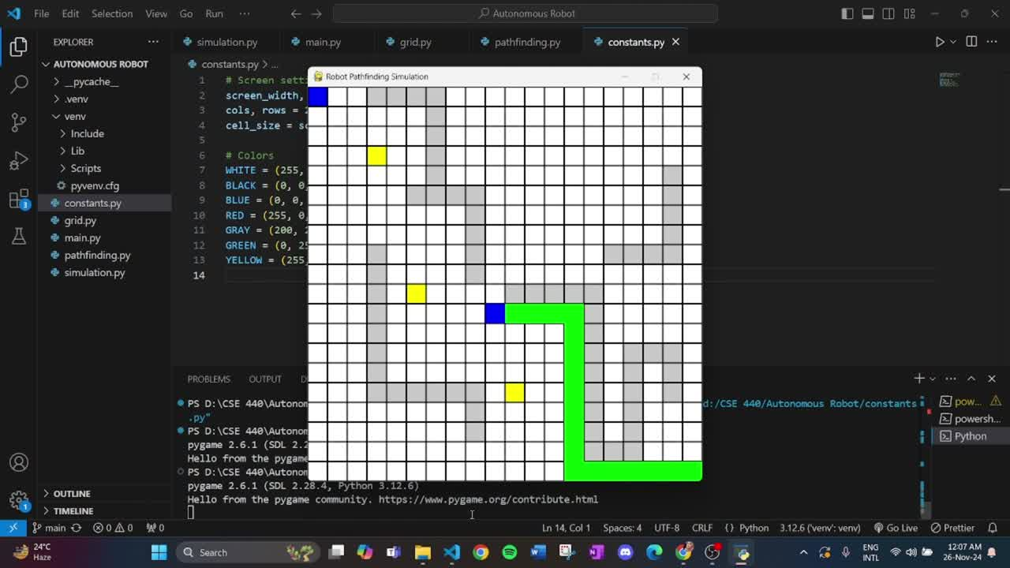
Demonstration
Back to Contents

Slide 11
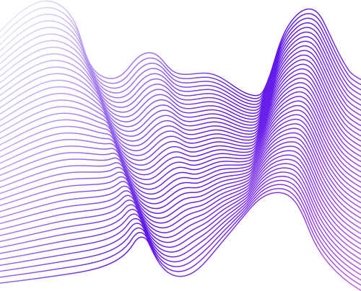
Future Work Plan
Back to Contents
Enhancements
Handling Dynamic Obstacles: Currently, the pathfinding is static, meaning obstacles are fixed during navigation. Future work will focus on allowing the robot to detect and avoid new obstacles that appear mid-navigation, adjusting its path dynamically.
Graphical Enhancements:
Color Distinctions: Improve the visual clarity of the grid by using clearer color coding to distinguish between obstacles, the path, and other elements.
3D Implementation: Transitioning to a 3D environment could enhance the realism and applicability of the project, simulating a more complex environment.

Slide 12
Future Work Plan
Back to Contents
User Interactivity
Allow users to modify grid size and place obstacles freely, increasing the flexibility of the simulation.
Provide options to set the robot’s start and goal positions interactively.

Slide 13
Conclusion
Back to Contents
The project successfully implemented an autonomous robot navigation system using the A* algorithm within a 2D grid environment. It demonstrated the robot's ability to calculate the optimal path and navigate around obstacles efficiently.
Key Takeaways:
Understanding Pathfinding: This project provided a solid understanding of how pathfinding algorithms like A* work in real-world applications, particularly in robotics.
Future Potential: With improvements, this system can be adapted for more complex real-world robotics applications, such as dynamic navigation and obstacle avoidance in unpredictable environments.

Slide 14
1 | Python’s official documentation (https://docs.python.org/).
2 | Pygame’s official guide (https://www.pygame.org/docs/).
3 | "Introduction to Algorithms" by Cormen et al.
4 | Online tutorials and resources (GeeksforGeeks).
5 | Finxter academy: https://academy.finxter.com/python-a-search-algorithm/
REFERENCES

Slide 15
THANK
YOU
for your patience
Feel free to ask us anything!

